Slide 1
Reconciling SCXML Statechart Representations and Event-B Lower Level Semantics
Karla Morris : Sandia National Laboratories, CA, USA
Colin Snook : University of Southampton, UK

Slide 2
Outline
Motivation
Model Representations
SCXML
iUML-B
Similarities & Differences in the Semantics
Extensions to SCXML
Prototype System Model
Future Work
Conclusions

Slide 3
Motivation
Event-B provides verification by formal proof…
… but notation is restricted to simplify verification.
Engineers are used to a richer notation..
.. they may find the restrictions difficult to accept.
iUML-B State-machines help but still close to Event-B.
Can Harel style state-chart semantics be reconciled with iUML-B?
We investigate a translation from SCXML state-charts to iUML-B state-machines (and hence to Event-B).

Slide 4
SCXML: State Chart eXtensible Markup Language
State Chart XML :
State Machine Notation for Control Abstraction
XML notation
Harel Statecharts
Related to CCXML Call Control XML, event-based telephony
Executable (via simulator tools)

Slide 5
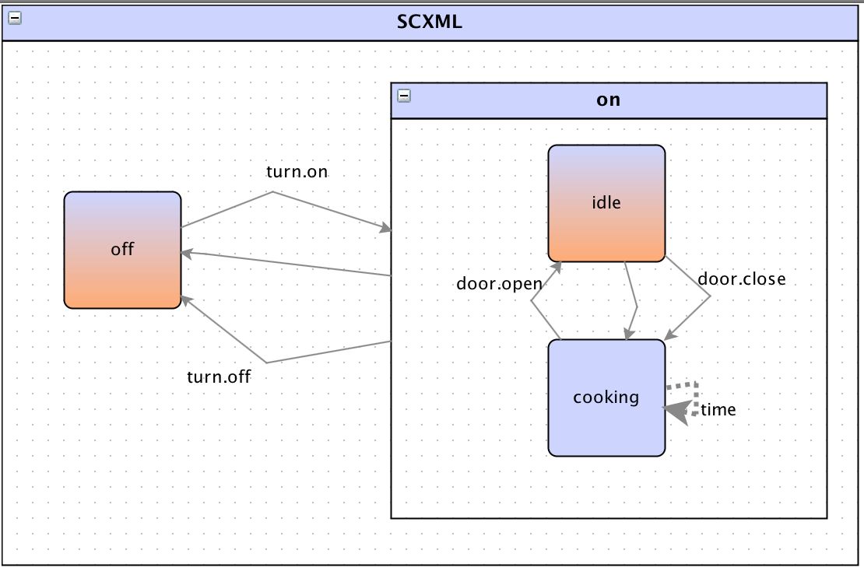
SCXML
<state id="on">
<initial>
<transition target="idle"/>
</initial>
<!-- on/pause state -->
<transition event="turn.off" target="off"/>
<transition cond="timer = cook_time" target="off"/>
<state id="idle">
<!-- default immediate transition if door is shut -->
<transition cond="door_closed" target="cooking"/>
<transition event="door.close" target="cooking">
<assign location="door_closed" expr="true"/>
<!-- start cooking -->
</transition>
</state>
<state id="cooking">
<transition event="door.open" target="idle">
<assign location="door_closed" expr="false"/>
</transition>
<!-- a 'time' event is seen once a second -->
<transition event="time">
<assign location="timer" expr="timer + 1"/>
</transition>
</state>
</state>
</scxml>
<?xml version="1.0"?>
<scxml xmlns="http://www.w3.org/2005/07/scxml"
version="1.0"
datamodel="ecmascript"
initial="off">
<!--trivial 5 second microwave oven example -->
<datamodel>
<data id="cook_time" expr="5"/>
<data id="door_closed" expr="true"/>
<data id="timer" expr="0"/>
</datamodel>
<state id="off">
<!-- off state -->
<transition event="turn.on" target="on"/>
</state>

Slide 6
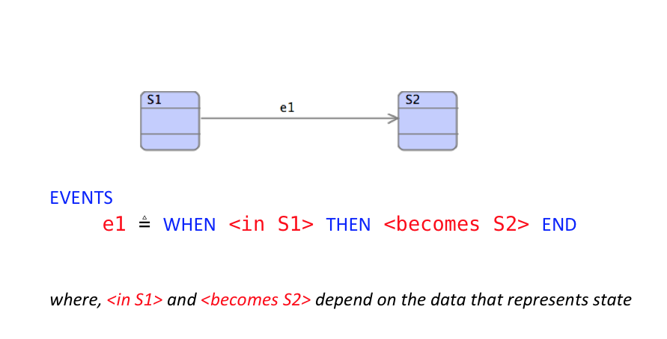
iUML-B Statemachines

Slide 7
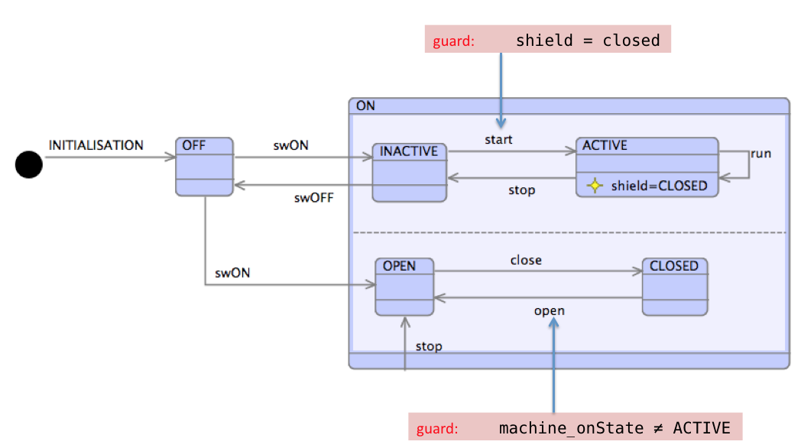
iUML-B Statemachines

Slide 8
Similarities between SCXML and iUML-B
Hierarchical nested state-charts
Transitions with
Conditions / Guards
Actions
States can have Entry and Exit Actions
(use with care in iUML-B)

Slide 9
Differences between SCXML and iUML-B
Event-B has..
Refinement
Invariants
Atomic Actions
SCXML has..
External Trigger events
Hence transitions do not have a name/label
Sequential actions
Run to Completion – Big step/little step

Slide 10
SCXML Extensions
XML tools allow new meta-model ‘namespaces’ to be introduced.
Existing SCXML tools will ignore them
Needed in order to support:
Refinement levels (new attribute <iumlb:refinement …>)
Invariants (new element <iumlb:invariant …>)
Guards (new element <iumlb:guard …>)

Slide 11
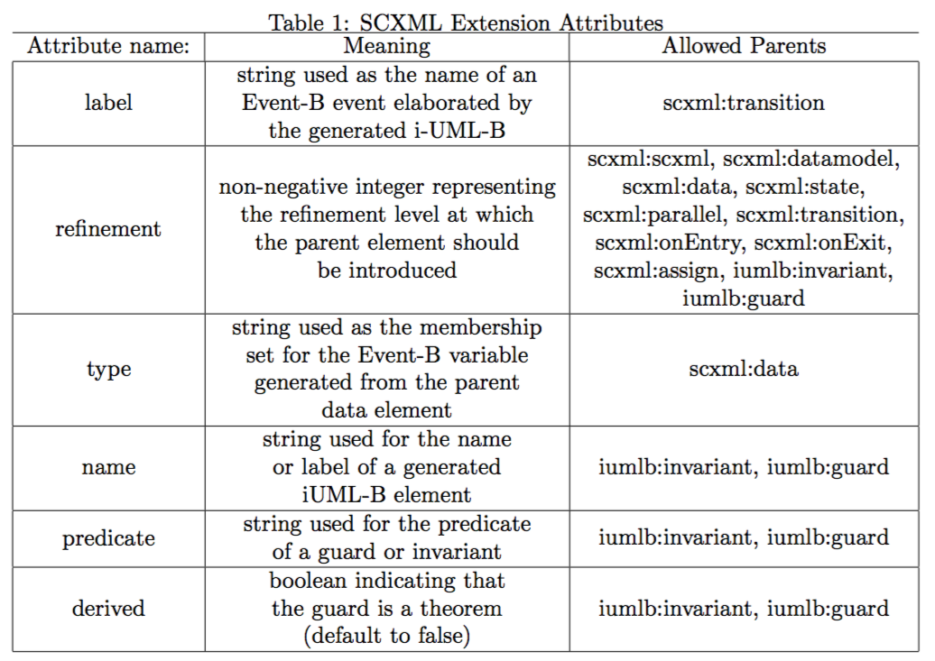
SCXML Extension Attributes

Slide 12
Example extended SCXML (extensions are captured in red)
<datamodel iumlb:refinement="2">
<data expr="false" id="Gate_In.Block" iumlb:type="BOOL"/>
</datamodel>
<!-- Other model details -->
<state id="BLOCKED">
<transition cond="[On_In.CardAccept==true]" target="UNBLOCKED">
<iumlb:guard name="gd1" predicate="On_In.CardAccept==true" refinement="2"/>
<assign expr="true" location="Gate_In.Block" iumlb:refinement="3"/>
</transition>
<onentry>
<assign expr="true" location="Gate_In.Block"/>
<assign expr="false" location="On_In.Reset"/>
</onentry>
<onexit>
<assign expr="false" location="Gate_In.Block"/>
</onexit>
<iumlb:invariant predicate="Gate_In.Block == TRUE" name="GateCondition"/>
</state>

Slide 13
Initial translation supports..
Data models
Hierarchical nested statemachines
Parallel Statemachines
‘When’ Transitions (label)
Transition parameters, guards and actions
Invariants
Initial and Final states
Refinement (superposition only)

Slide 14
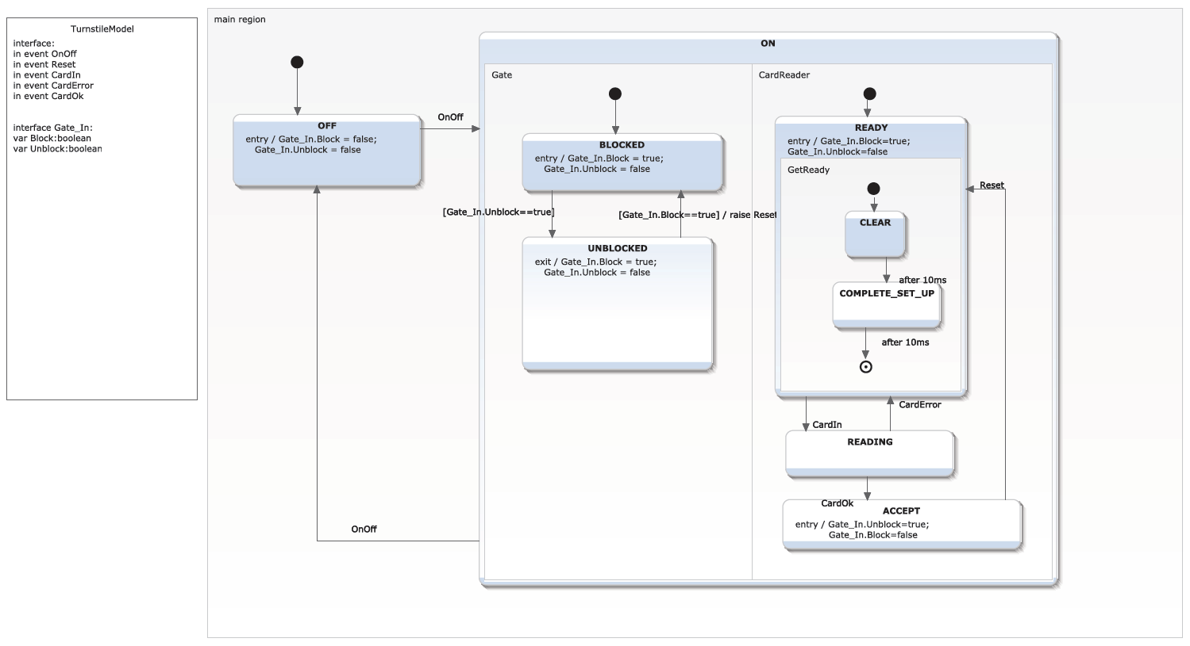
Diagram of SCXML

Slide 15
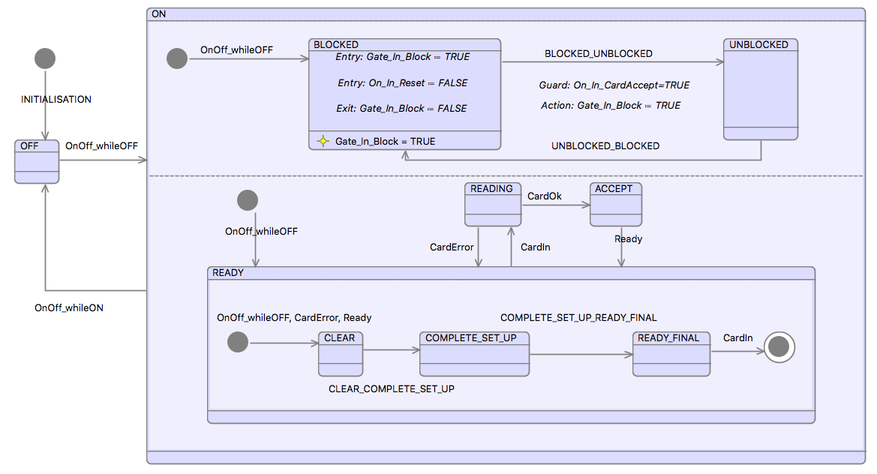
Example – generated iUML-B

Slide 16
Next steps
Try modelling the run to completion semantics
E.g. trigger events create a token,
A new token can only be consumed when no transitions are enabled
Try enforcing transition run-to-completion sequences
Still omit sequencing of actions

Slide 17
First Strategy:
iUML-B Statemachines will own a collection of triggers.
Each trigger will generate an Event-B BOOL variable.
(Note simplification of SCXML, which permits several triggers of a kind to be queued)
Transitions may reference a trigger.
The reference will generate a guard, <trigger variable> = TRUE
And an action <trigger variable> := FALSE.
Transitions may own a collection of ‘Raise’ actions that reference an internal trigger.
This will generate an action <trigger variable> := TRUE.
Trigger may be designated as external event.
An trigger event will be generated to create a new trigger (<trigger variable> := TRUE )
when it has been consumed ( <trigger variable> = FALSE ) and
no transitions are enabled. (run to completion)
A partial ‘run-to-completion’ semantics will be introduced by disabling all trigger events while any external or internal transition is enabled.

Slide 18
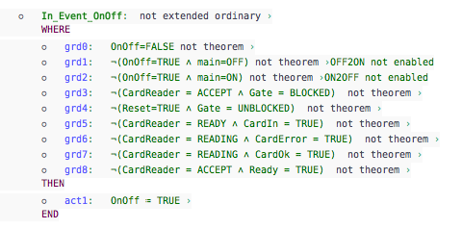
First Strategy: External trigger event
Old trigger has been consumed
No transitions enabled
Raise new trigger

Slide 19
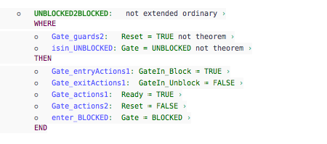
First Strategy: Triggered transition
The trigger guard
Raise an internal trigger
Consume the external trigger

Slide 20
Second Strategy:
Two phases:
Triggers are accumulated in one phase and consumed in the next phase
Phases overlap, next triggers are accumulated while last is consumed
Trigger events are accumulated in a set NEXT
Trigger events are consumed from a set NOW
A step event copies NEXT to NOW and clears NEXT
Raising trigger events
An event representing an external trigger
Or a transition with a “Raise’’ action
All triggers are added to NEXT
A partial ‘run-to-completion’ semantics will be introduced
by disabling the step event while any transition is enabled

Slide 21


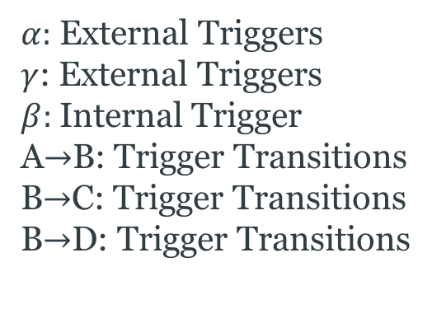
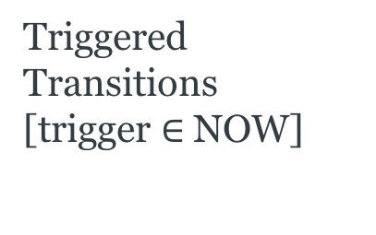




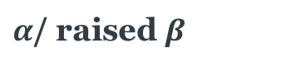
Second Strategy:
C
$α:$ External Triggers
$γ$: External Triggers
$β:$Internal Trigger
A$→$B: Trigger Transitions
B$→$C: Trigger Transitions
B$→$D: Trigger Transitions
$$β$$
A
$α$/ raised $β$
B
$$γ$$
D
Set NEXT
{ }
Step
Set NOW
{ }
Triggered Transitions
[trigger $∈$NOW]
Trigger Events
$$α$$
No enable transitions
$$α$$
$$β$$
$$β$$
Raised Trigger
Two phases:
Triggers are accumulated in one phase and consumed in the next phase
Phases overlap, next triggers are accumulated while last is consumed
Trigger events are accumulated in a set NEXT
Trigger events are consumed from a set NOW
A step event copies NEXT to NOW and clears NEXT
Raising trigger events
An event representing an external trigger
Or a transition with a “Raise’’ action
All triggers are added to NEXT
A partial ‘run-to-completion’ semantics will be introduced
by disabling the step event while any transition is enabled

Slide 22
Second Strategy: basis
We start with a ‘basis’ Event-B machine
Abstract representation of the run to completion ‘step’ behaviour
In Refinements
We will add new transitions and triggers
This will generate new events that modify old variables (NOW and NEXT)
We provide ‘basis’ events for future events to refine
Future transitions event (parameters T, R)
Refinements add guard to define T = {<theNewTriggers>}
Refinements add guard to define R = {<theNewRaisedTriggers>}
Future trigger event (parameters t)
Refinements add guard to define t = <theNewTrigger>

Slide 23
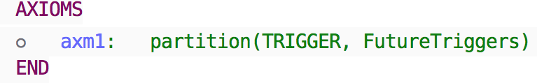
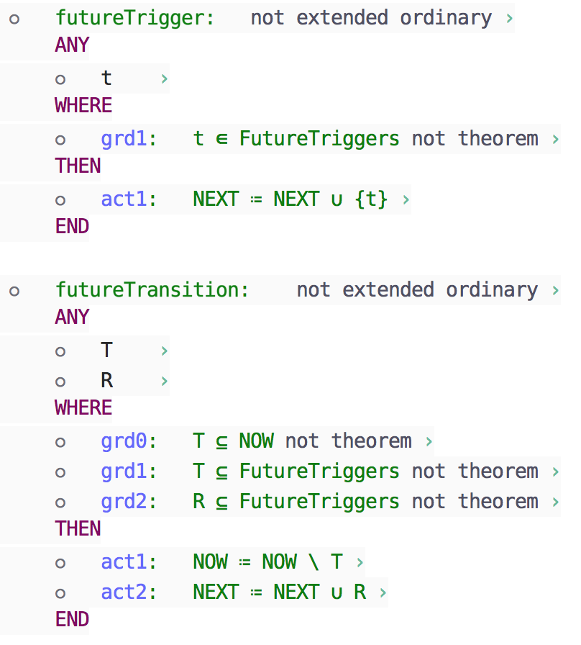
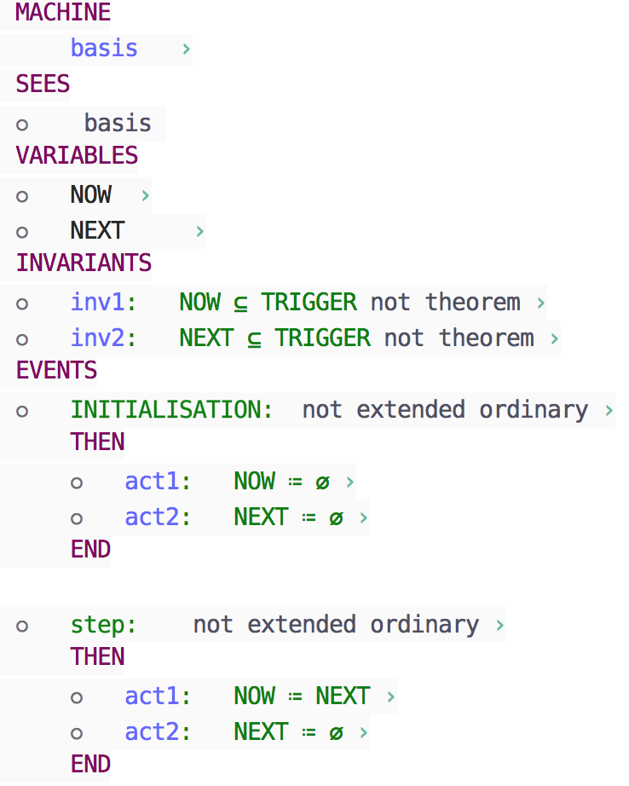
Second Strategy: basis

Slide 24
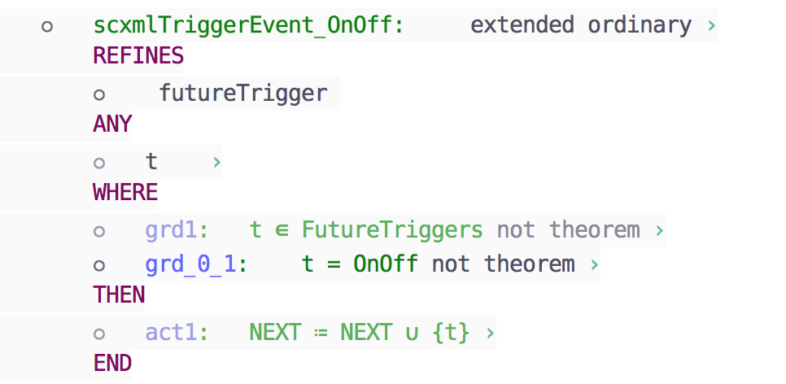
Second Strategy: External trigger event
Define new Trigger
(action from basis)
Add new trigger to the NEXT set

Slide 25
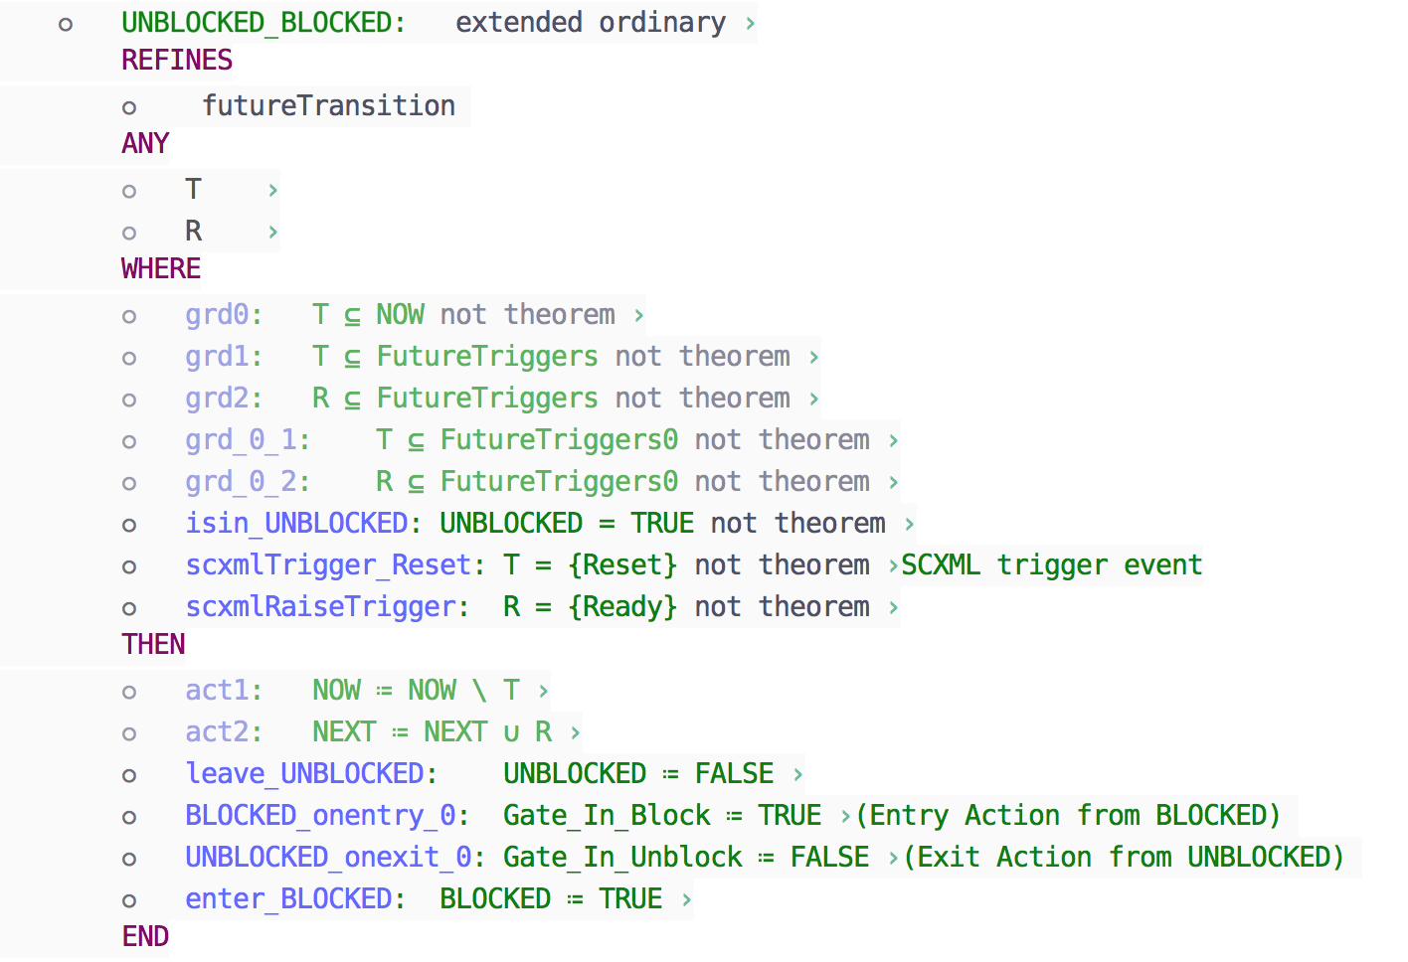
Second Strategy: Triggered transition
The trigger guard
Raise an internal trigger
(actions from basis)
Consume the external trigger and raise internal ones

Slide 26
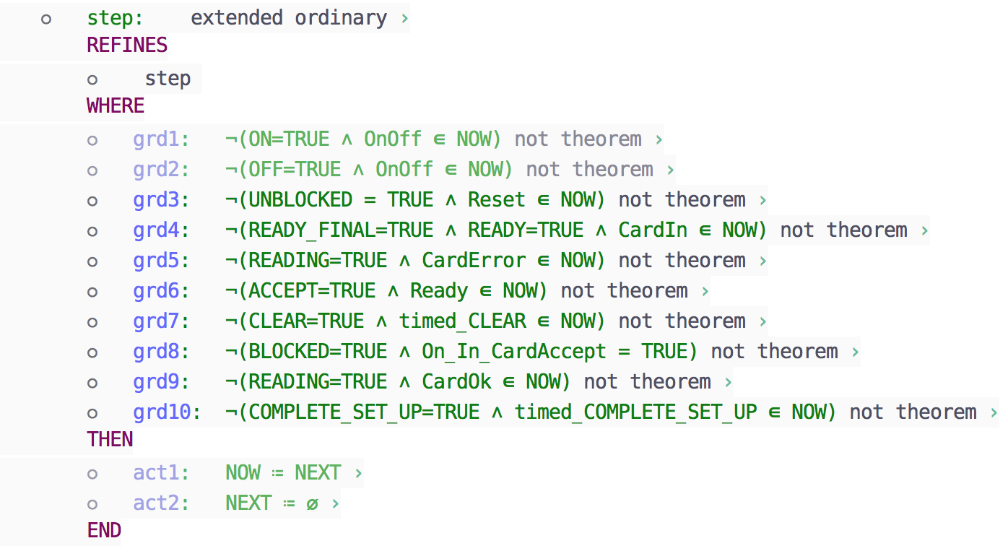
First Strategy: Step Event
No transitions enabled
(actions from basis)
Problem:
if guard of an existing transition is strengthened,
corresponding guard in step is weakened

Slide 27
Conclusions
Strong motivation from engineers
Difficult to reconcile semantic differences
Run-to-completion, Sequential execution
We adopt a compromise
Support what we can
Add extensions where necessary
Otherwise, restrict SCXML

Slide 28
Thank you
Questions?

Slide 29
Next steps
Try modelling the run to completion semantics
E.g. trigger events create a token,
A new token can only be consumed when no transitions are enabled
Try enforcing transition run-to-completion sequences
Still omit sequencing of actions

Slide 30
Enhance iUML-B to support triggers
iUML-B Statemachines will own a collection of triggers.
Each trigger will generate an Event-B BOOL variable.
(Note simplification of SCXML, which permits several triggers of a kind to be queued).
Transitions may reference a trigger.
The reference will generate a guard, <trigger variable> = TRUE
And an action <trigger variable> := FALSE.
Transitions may own a collection of ‘Raise’ actions that reference an internal trigger.
This will generate an action <trigger variable> := TRUE.
Trigger may be designated as external event.
An trigger event will be generated to create a new trigger ( <trigger variable> := TRUE )
when it has been consumed ( <trigger variable> = FALSE ) and
no transitions are enabled. (run to completion)
A partial ‘run-to-completion’ semantics will be introduced by disabling all trigger events while any external or internal transition is enabled.

Slide 31
External Trigger Event
Old trigger has been consumed
No transitions enabled
Raise new trigger

Slide 32
Triggered transition
The trigger guard
Raise an internal trigger
Consume the external trigger

